Slide 1
Creating a React Application
Creating an application
Running the application

Slide 2
1. Creating an Application
Overview
Creating a React TypeScript app
Reviewing the application
Application home page
Source code entry point
Functional components

Slide 3
Overview
We'll use TypeScript for our React demos today
(JavaScript demos are also available in the downloads)
We're going to use the Create React App tool
Generates a template app, config, etc.
See https://create-react-app.dev/
All you need installed is Node.js version 10 or above
You can get it from https://nodejs.org/en/
3

Slide 4
Creating a React TypeScript Application
You can use Create React App as follows, to create a React application using TypeScript:
This command also downloads React libraries and dev tools into the node_modules folder
As specified in the package.json file
npx create-react-app demo-app --template typescript
4

Slide 5
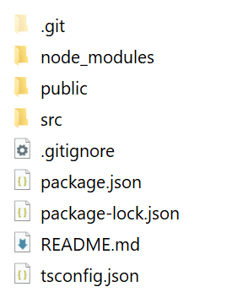
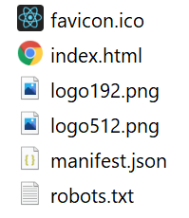
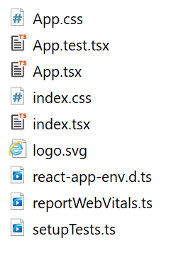
Reviewing the Application
Here's the structure of the generated application:
public folder
src folder
5

Slide 6
Application Home Page
The application home page is public/index.html
<!DOCTYPE html>
<html lang="en">
<head>
<title>React App</title>
…
</head>
<body>
<div id="root"></div>
</body>
</html>
public/index.html
6

Slide 7
Source Code Entry Point
The source code entry point is src/index.tsx
Aside: For info about React "strict mode", see:
https://reactjs.org/docs/strict-mode.html
import React from 'react';
import ReactDOM from 'react-dom';
import './index.css';
import App from './App';
…
ReactDOM.render(
<React.StrictMode>
<App />
</React.StrictMode>,
document.getElementById('root')
);
src/index.tsx
7

Slide 8
Functional Components
In the generated code, App is a functional component
import React from 'react';
import './App.css';
…
function App() {
return (
<div className="App">
<header className="App-header">
<img src={logo} className="App-logo" alt="logo" />
… Plus other HTML content …
</header>
</div>
);
}
export default App;
src/App.tsx
8

Slide 9
3. Running the Application
Running the app in dev mode
Hot reloading
Testing the app
Building the app for production
Serving the production application
Pinging the production application

Slide 10
Running the App in Dev Mode (1 of 3)
You can run the app in dev mode as follows:
What this does:
Transpiles TS code into ES5 (as per tsconfig.json)
Transpiles JSX/TSX files into ES5 (via Babel)
Builds the application in memory (via Webpack)
Starts a dev server to host the application
The dev server is on http://localhost:3000
npm start
or
npx react-scripts start
10

Slide 11
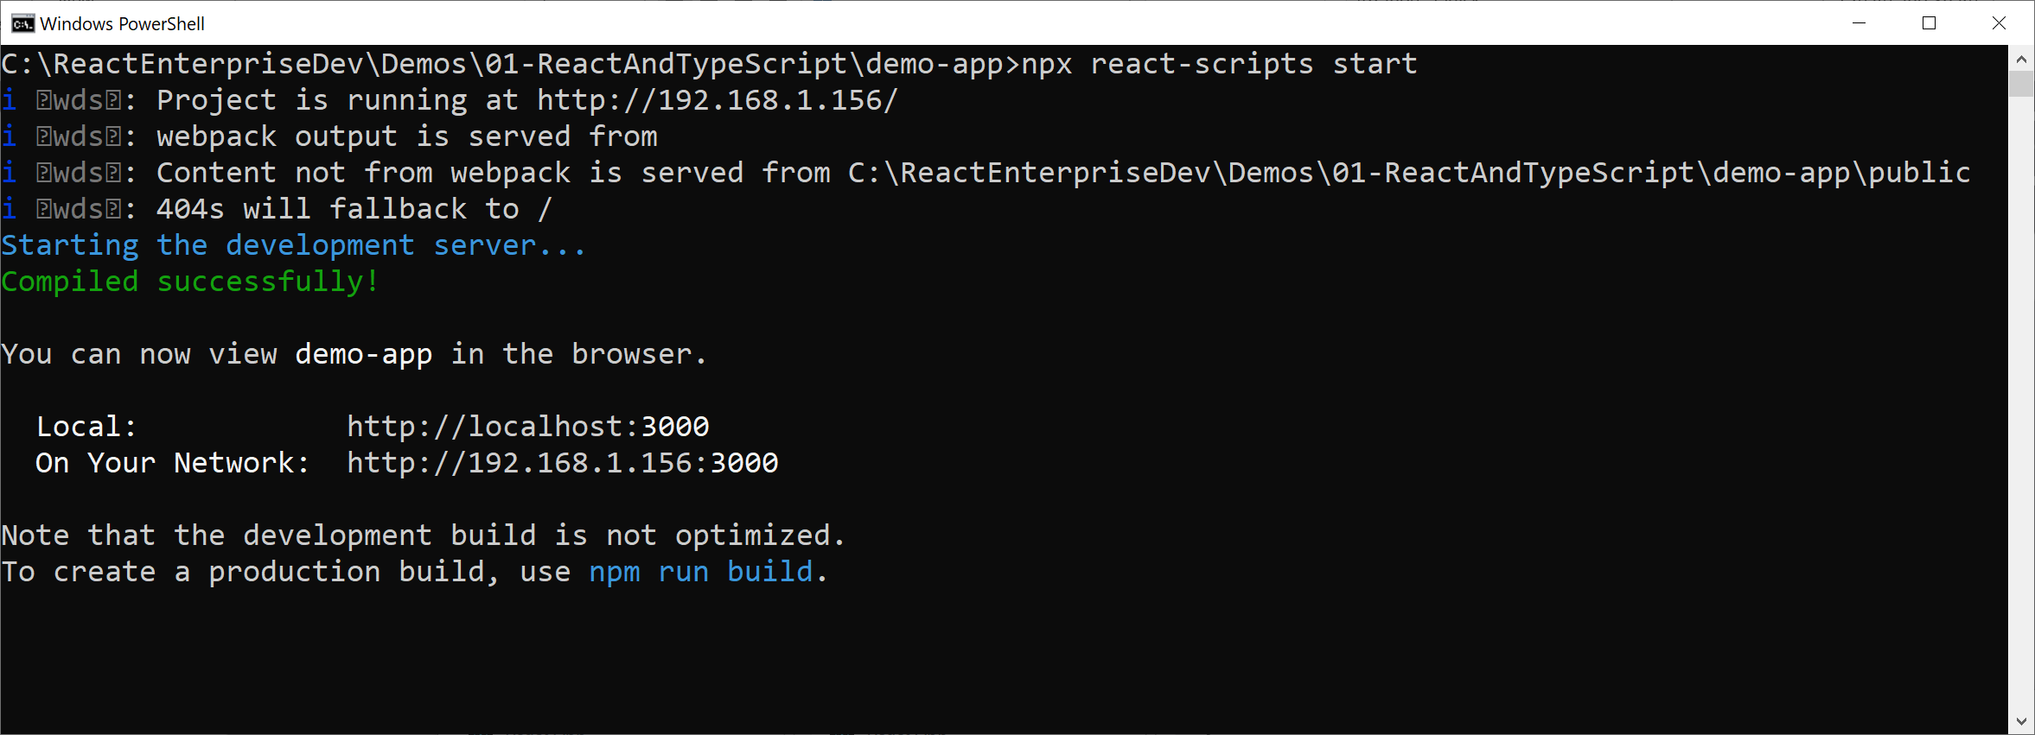
Running the App in Dev Mode (2 of 3)
Output from the command on the previous slide:
11

Slide 12
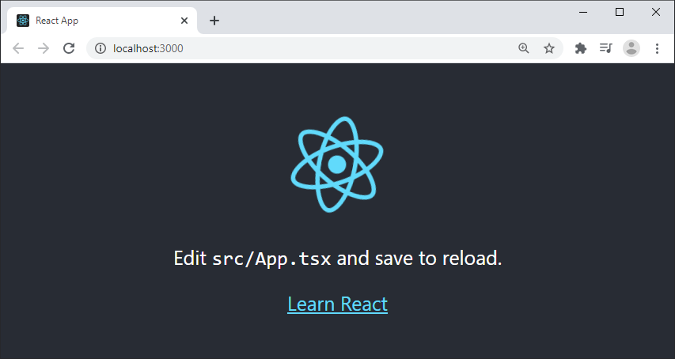
Running the App in Dev Mode (3 of 3)
Ping the app at http://localhost:3000/
12

Slide 13
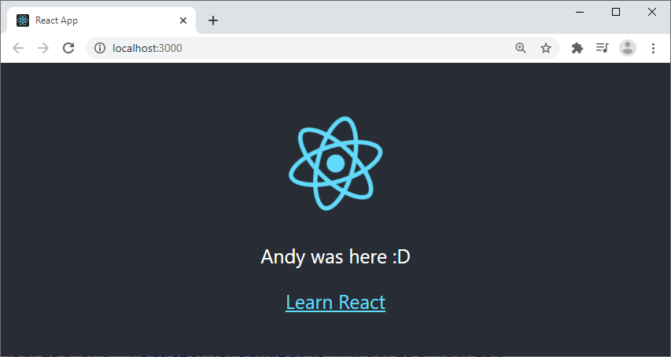
Hot Reloading
Hot reloading is supported
If you edit any source files, the app will be rebuilt and refreshed automatically in the browser
13

Slide 14
Building the Application for Production
You can build the application for production as follows:
This creates a build folder that contains a production build of your application
build/static/js/ - Minified JS "chunk" files
build/static/css/ - Minified CSS files
build/static/media/ - Media files (e.g. images)
npm run build
or
npx react-scripts build
14

Slide 15
Serving the Production Application
You can now run the application on a production server
E.g. install the Node "serve" server:
Then serve the production build of the app as follows:
-s option - Location of app (i.e. the build folder)
-l option - Port to listen on (default is 5000)
npm install -g serve
serve -s build -l 8080
15

Slide 16
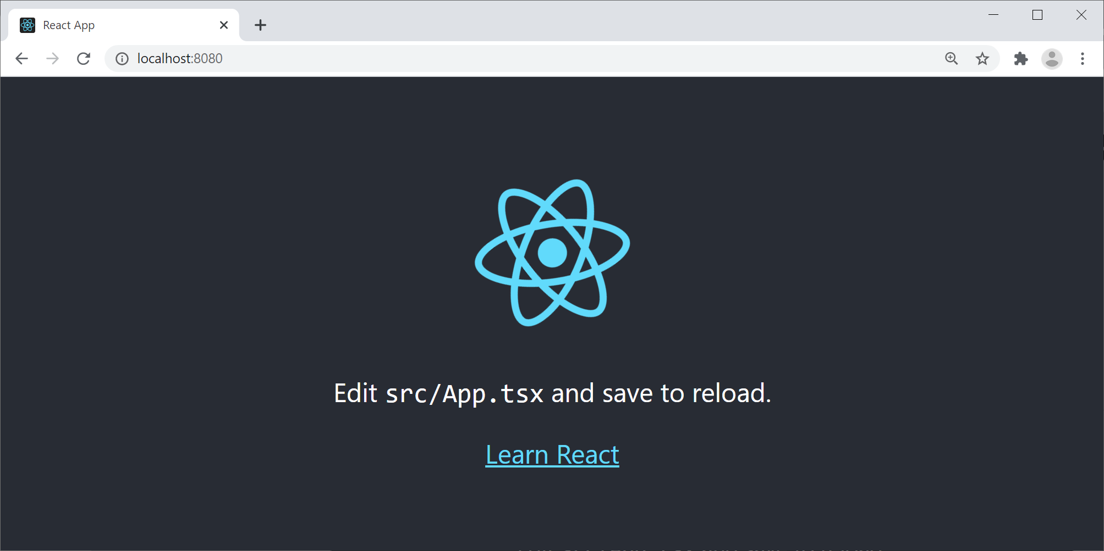
Pinging the Production Application
Open a browser and navigate to the following URL:
http://localhost:8080/
16

Slide 17
Summary
Setting the scene
Creating an application
Running the application

